Slide 1
Hub Selection Summary
Identify potential hubs using DBSCAN
Find 75 potential hubs [1]
Split hubs into 16 regions
Hub selection method
Generate original design and keep original hubs selected [2]
Consider a region A
Combine [1] of A with [2] of A
Solve regional network design problem
Potential hubs selected by the design become “small hub set candidates” [3]
Remove all hubs add
Solve the global network design problem using [3]
We do see improvements!

Slide 2
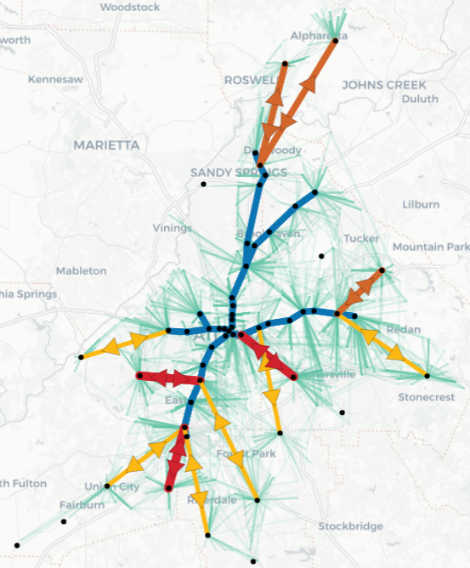
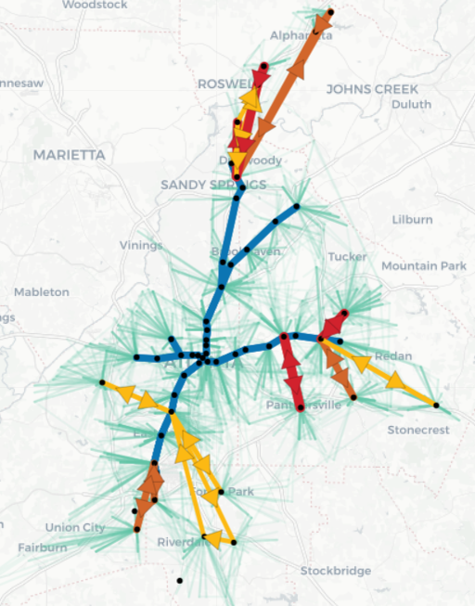
Old vs. New [Design]

Slide 3
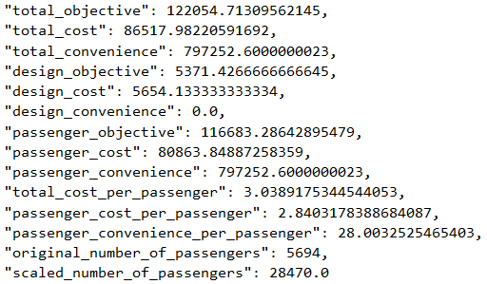
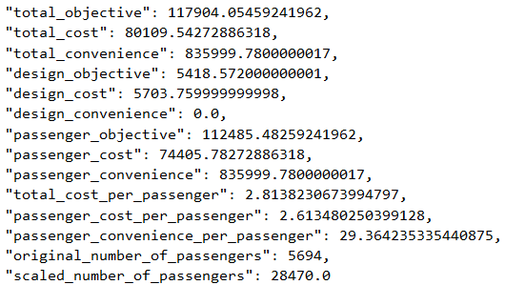
Old vs. New
[Result]
3.4%
7.4%
4.9%
8.7%
8.7%
4.0%
8.0%
8.9%
4.1%
7.4%
4.9%
15 locations selected
More hubs, lower passenger cost
Greater improvements after parameter tuning

Slide 4
Parameter Tuning
Tuned parameters
travelTimeFactorShuttle = 1.2 (1.0)
travelTimeFactorShuttle = 1.2 (1.0)
alpha = 0.05 (0.01)
mipgap = 1%
passengerFactor = 5.0 (1.0)
Total runtime: 497.22 seconds (around 8 mins)
New method reduces the runtime by a lot
Original method (adding all hubs at once): with the same amount of runtime, it only manages to reduce the gap error to around 37%, which is way larger than 1%
Running

Slide 5
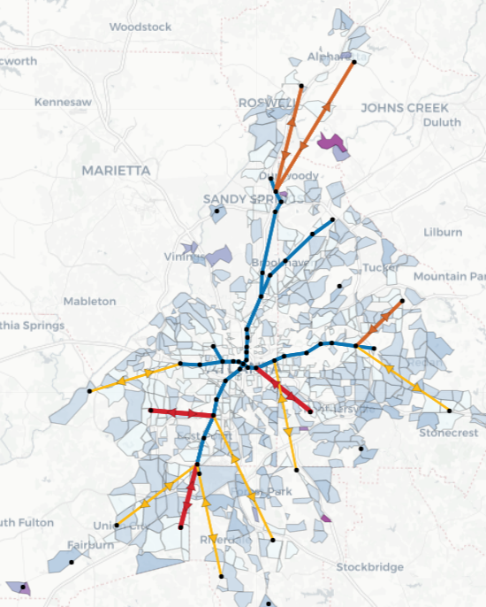
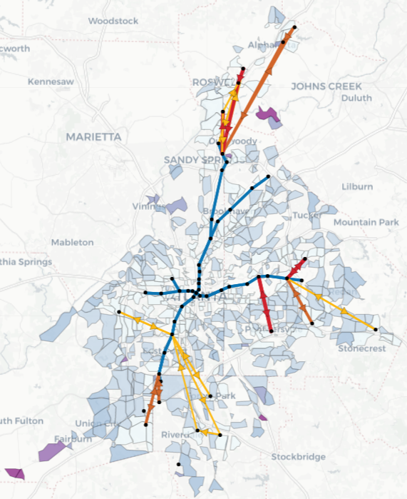
Old vs. New
[Cost]

Slide 6
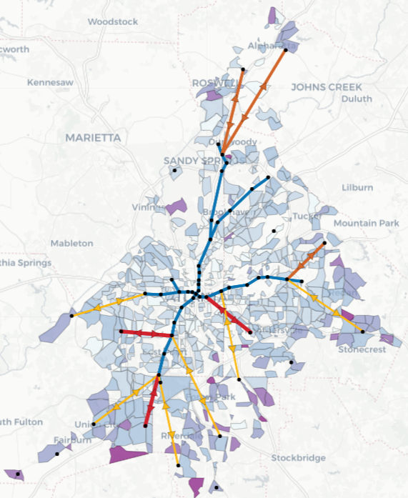
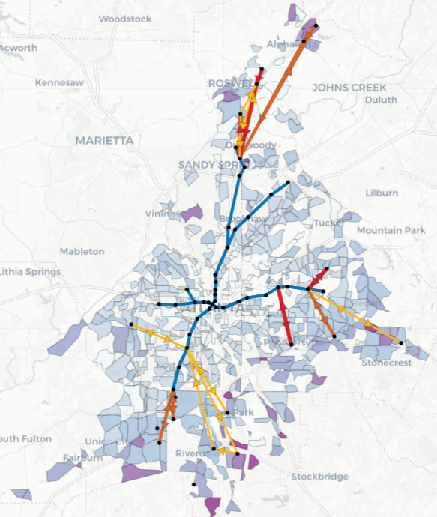
Old vs. New
[Convience]

Slide 7
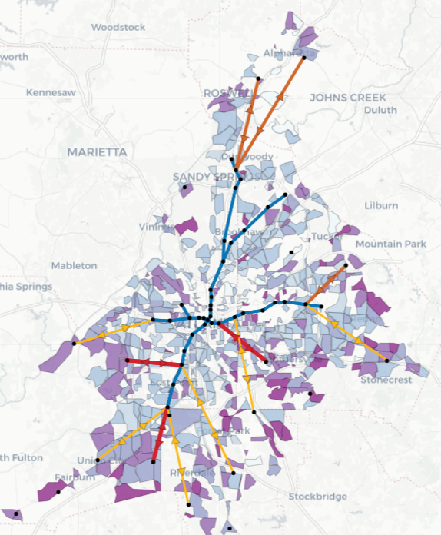
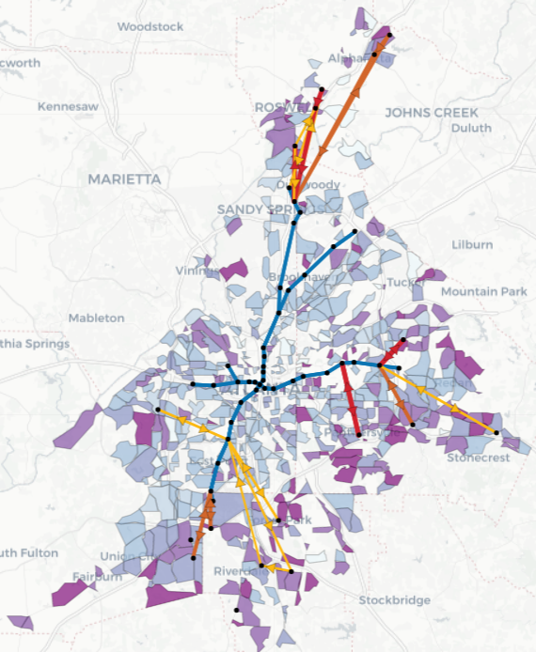
Old vs. New
[# of Transfer]

Slide 8
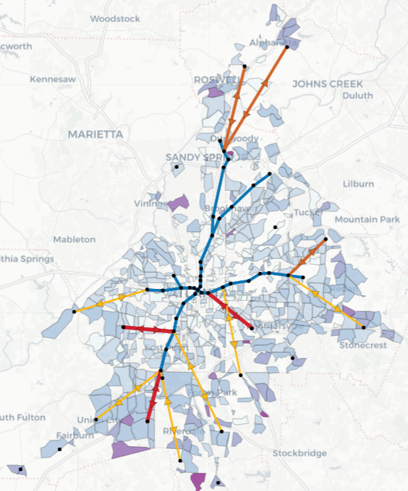
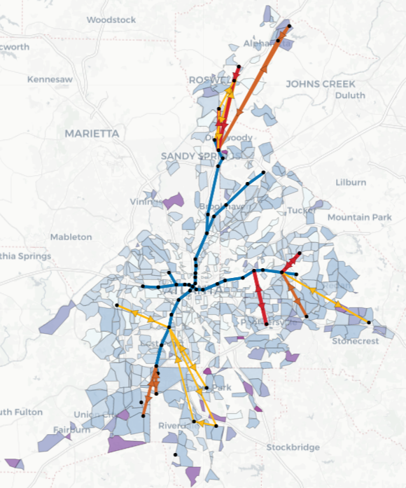
Old vs. New
[Travel Time]

Slide 9
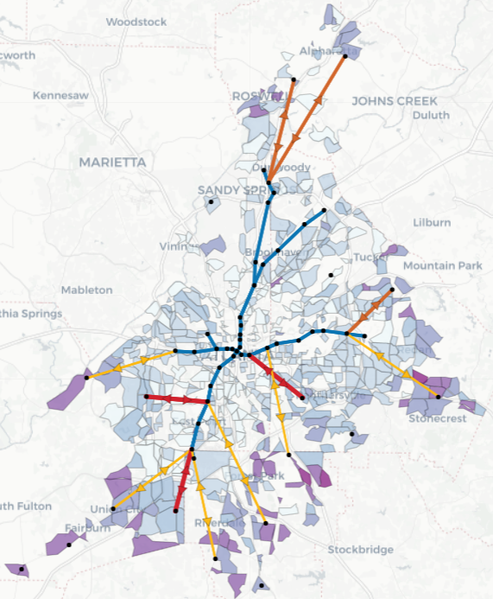
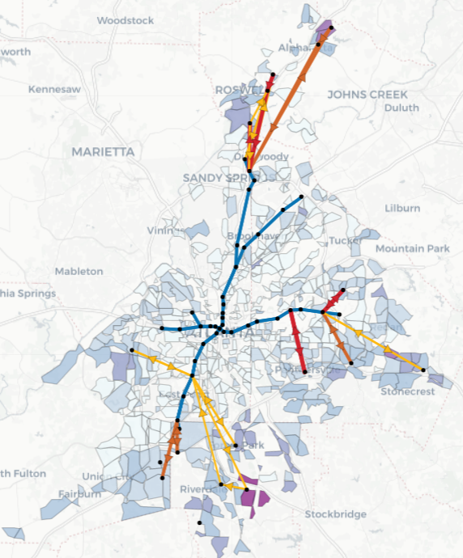
Old vs. New
[Wait Time]

Slide 10
Week 3 & 4 Plan
Make the scaling constant for all graphs
Starting using large ARC data
Goal: increase the population that utilize public transit system (currently 2%)
Use it to evaluate current network design (on MARTA data)
Generate new O-D pairs to design
Use it for hub selection (explore new ML method to find potential hubs)
Analysis
Current network design
Hub selection
Case study
Specific region
Areas of improvement
Study robustness
Etc.

